Slide 1
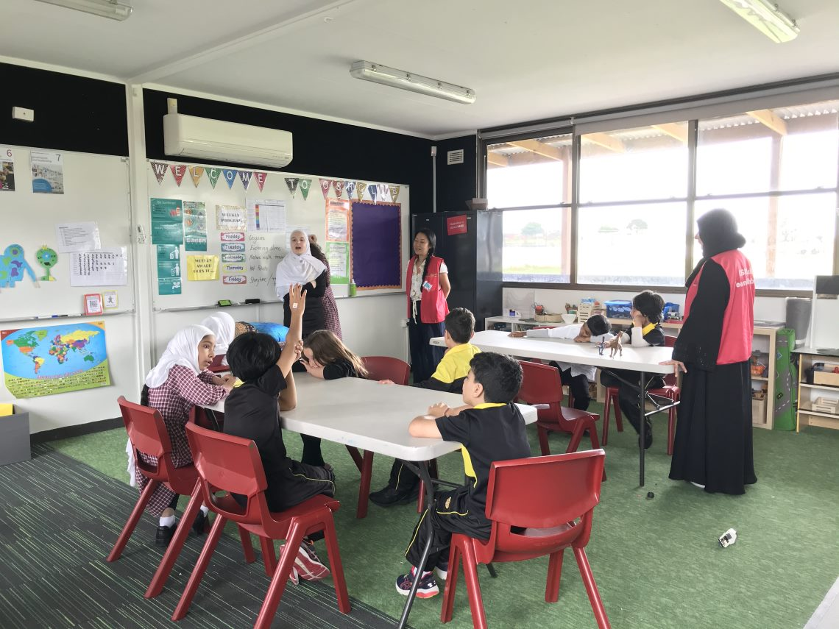

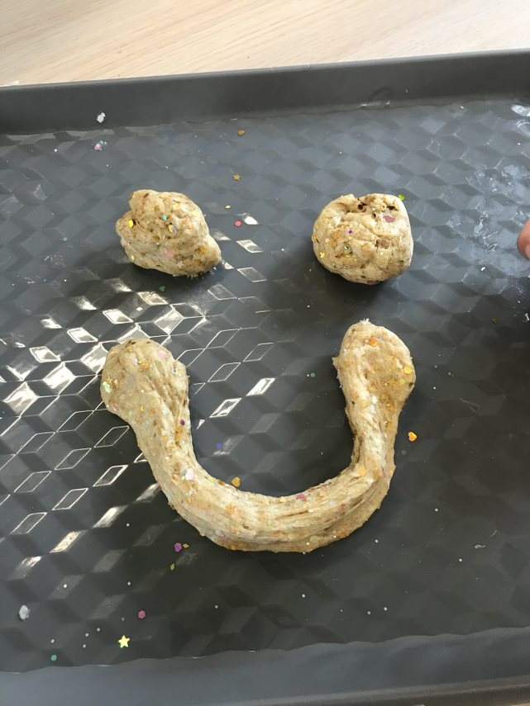
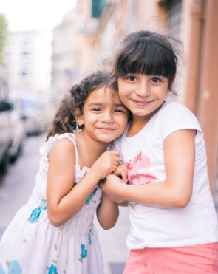


Here is Aicha conducting our weekly children’s meeting to decide what we will do for the following week.
WHAT’S BEEN HAPPENING…
Farewell Term 4
Hello everyone!
It is that time again where we say goodbye to the lovely children who have attended our OSHClub services. During Term 4 we have gotten to know and understand all our children and in turn they have had the pleasure to get to know us and meet more educators along the way. We have had lots of fun organising activities and preparing delicious food for the children and hope to see more faces next year!
From Miss Tien
Coordinator
SPECIAL ANNOUNCEMENTS
WELCOME TO OSHClub Miss Hanain
WELCOME TO OSHClub Miss Sara
WELCOME TO OSHClub Miss Arwa
WELCOME TO OSHClub Miss Shaeima
Farewell to Aicha Hamel and Amnah Khan, it is her last year with OSHClub. We will miss you!

Slide 2


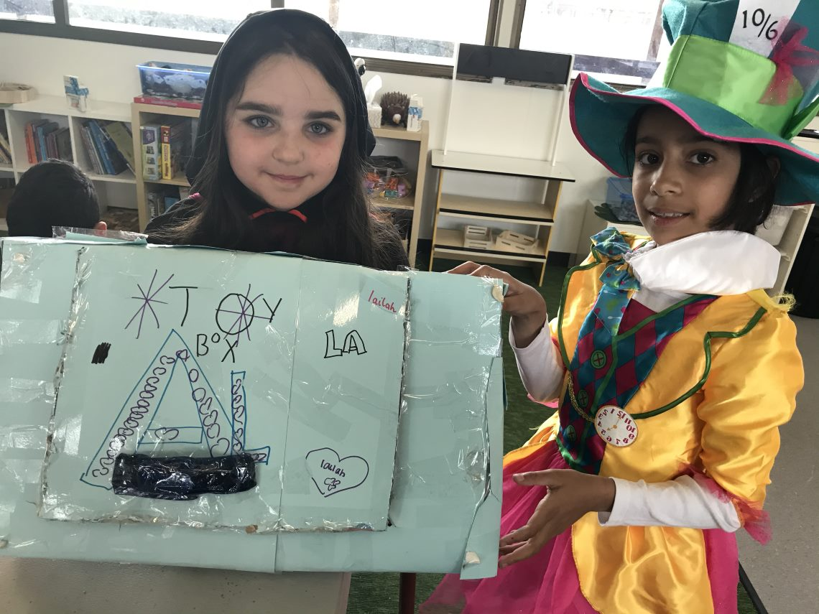
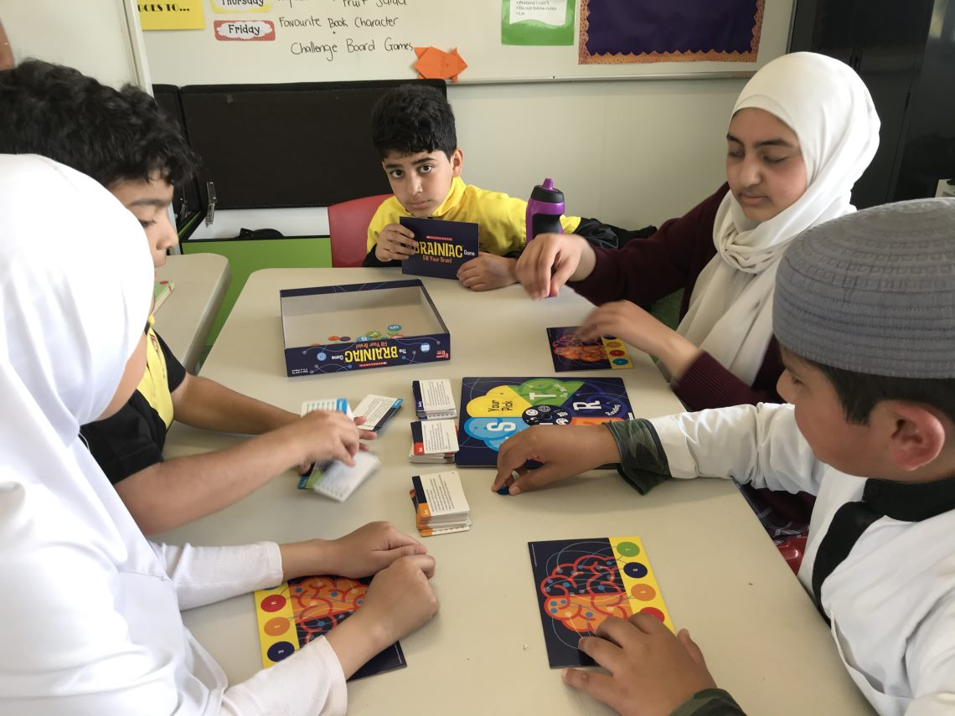
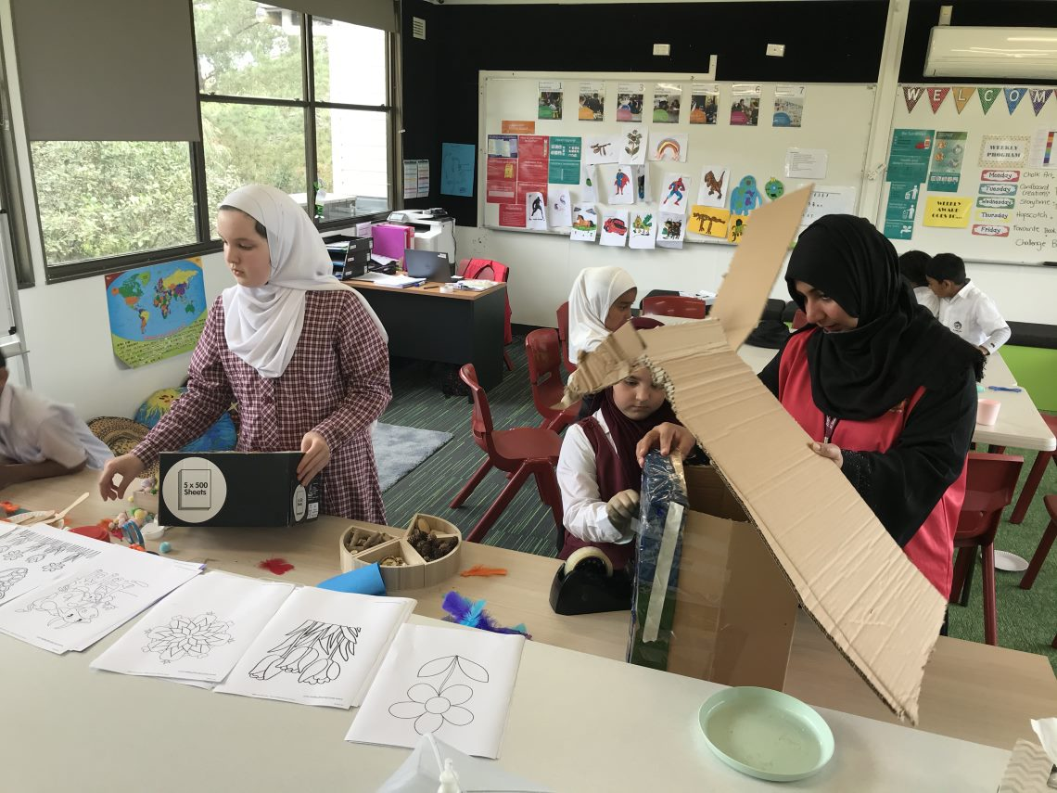
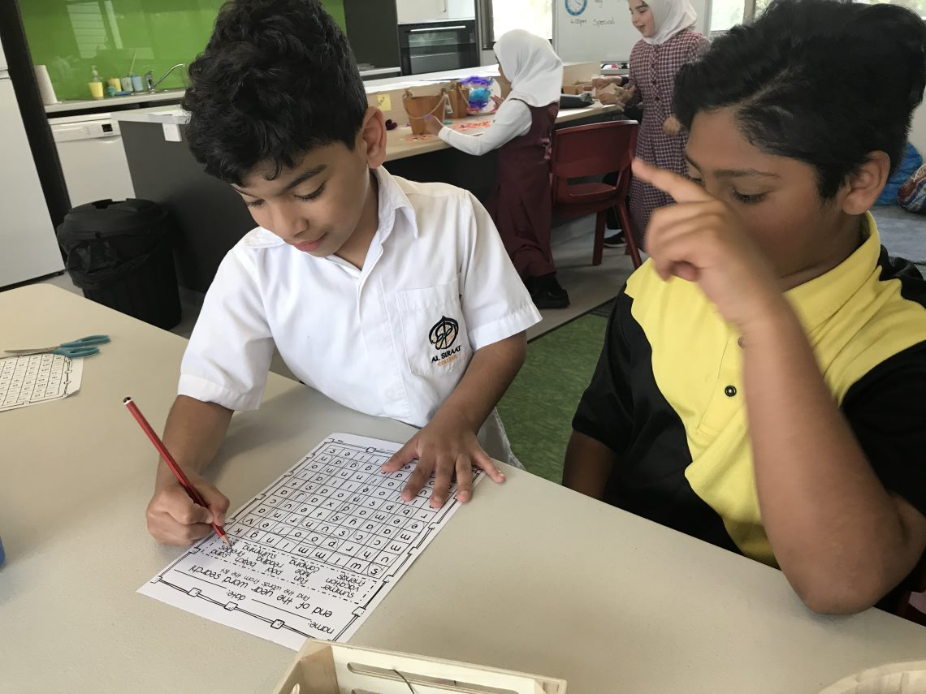
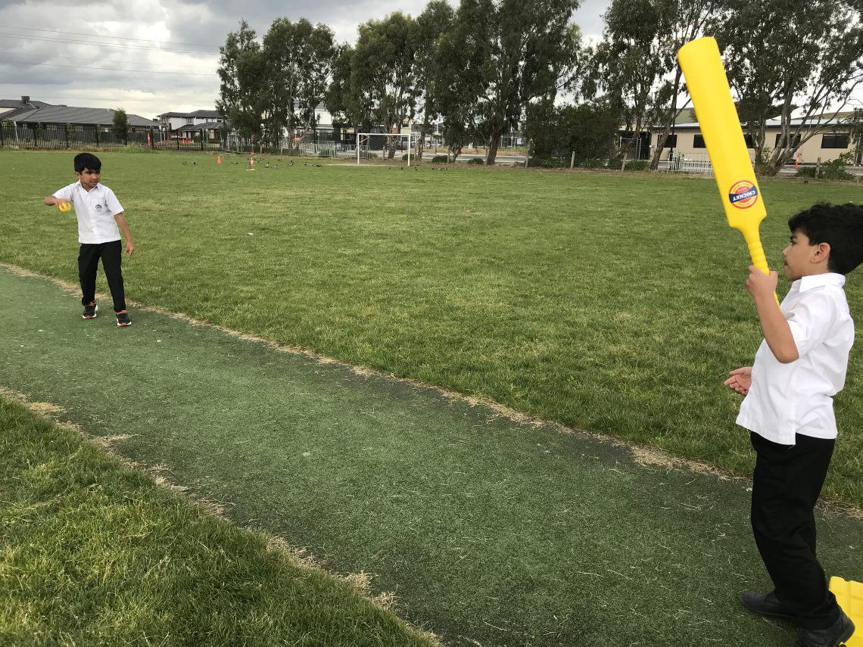
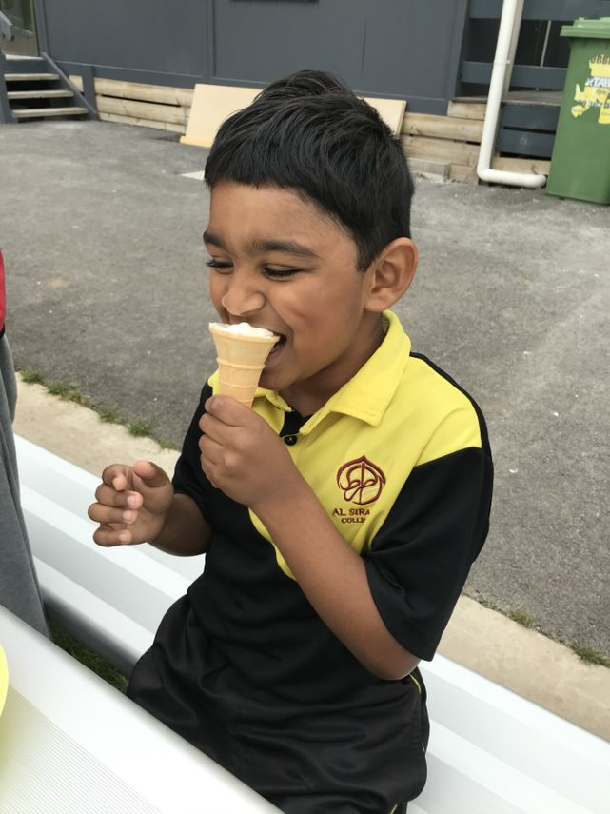
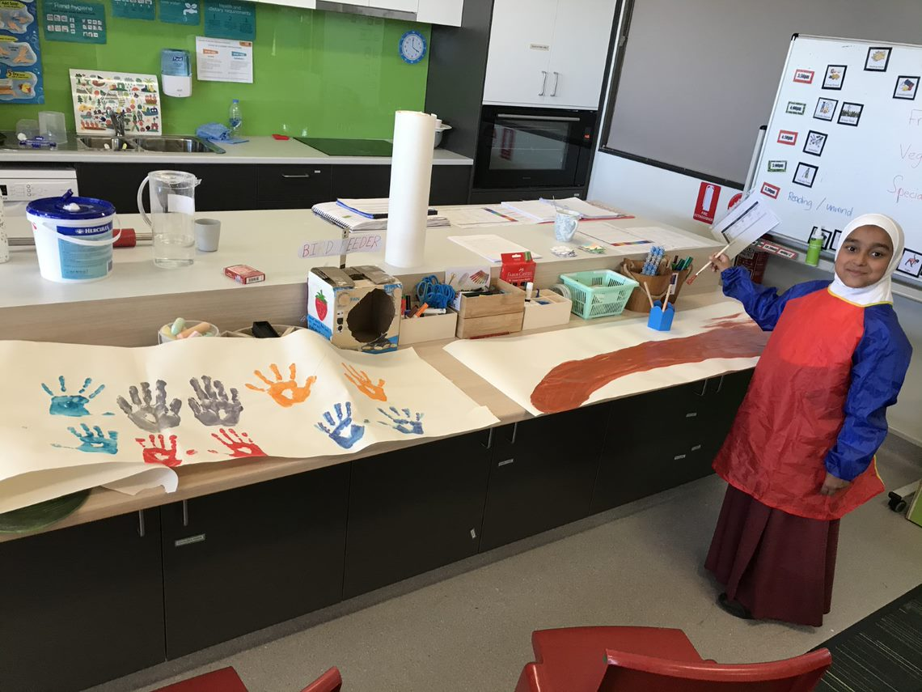
PHOTO GALLERY
RECIPE
Yoghurt Cones
Welcome back from OSHClub
What you will need:
Plain ice cream cones
Vanilla Yoghurt
Mixed berries or freshly diced watermelon
Method:
Take your ice cream cone and spoon in vanilla yoghurt as desired.
Top your cones with fresh berries or any diced fruit you love!
Serve it to your children and watch them eat!
Below is one happy customer
End of Term activities!
Fun water activities for the children!

